Slide 1


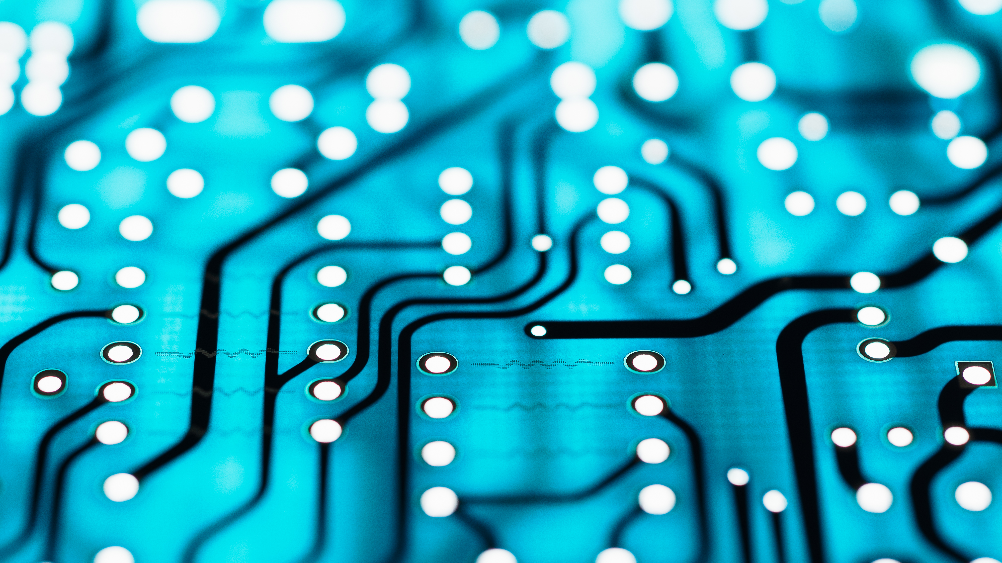
Driver Behavior Based On Deep Learning
Graduation project

Slide 2

Meet Our Team
Aya Sobhy Abd El-Hamid Hussain
Hardware Team
/ aya.sobhy.1485
@

Slide 3

Meet Our Team
Mohamed Mosad Mostafa Aman
Hardware Team
/mosad1998
@mosad1998

Slide 4

Meet Our Team
Shrouk Nabil Abd el-aal Melegy
Hardware Team
/ shorouk.nabil.1
@

Slide 5

Meet Our Team
Mohamed Mostafa Elsayed Hella
AI Team
/ mmh6198
mohamedhella98

Slide 6
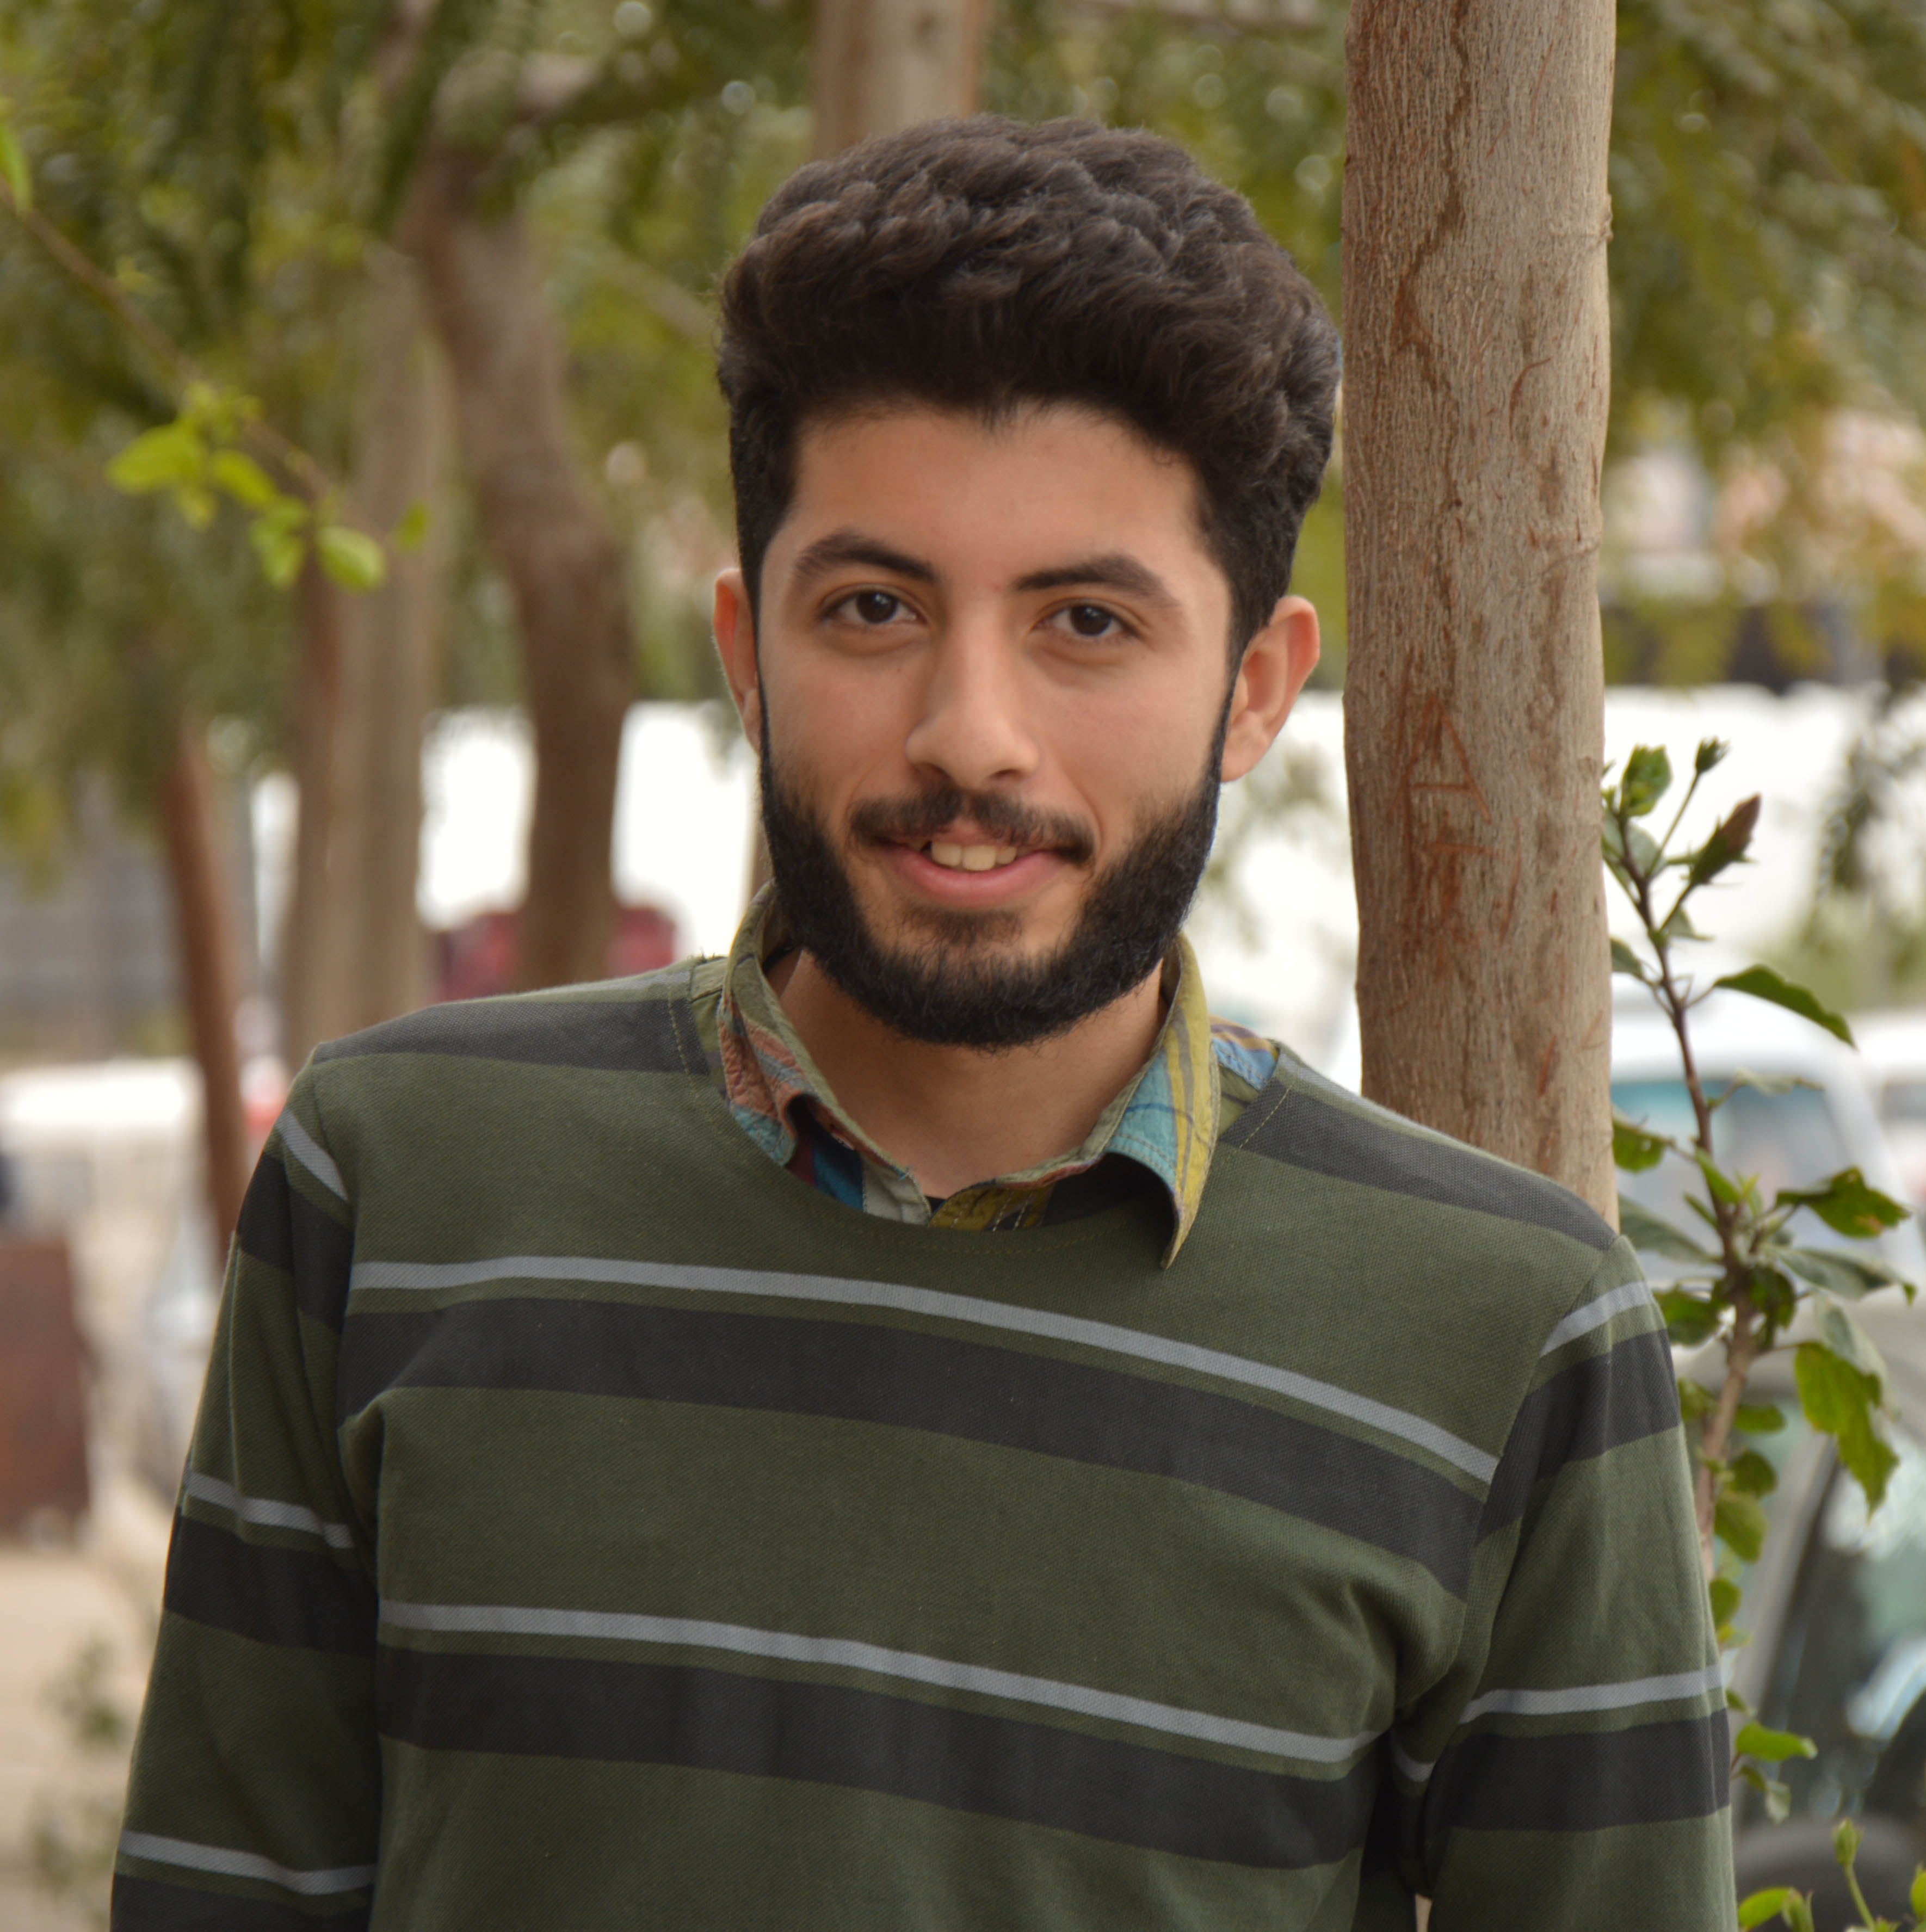
Meet Our Team
Mohamed Samir Mohamed Hussien
AI Team
/mohamedsamir124
@m7md_samir

Slide 7
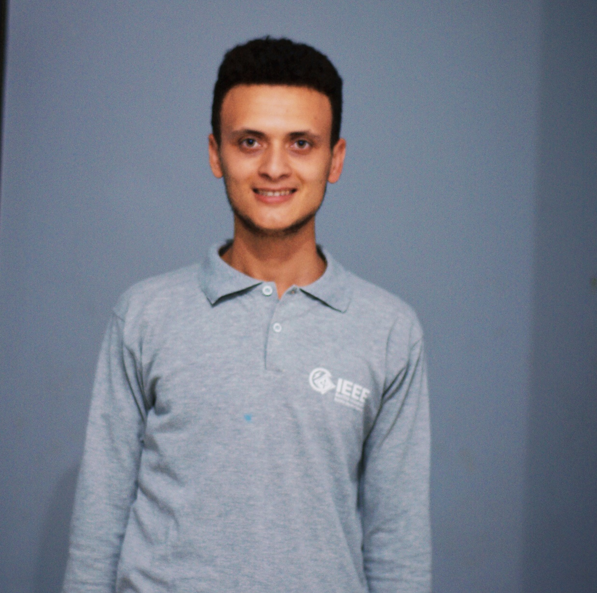
Meet Our Team
Mohamed Shaban Abd-Elnapi Zidan
AI Team
/I.Mohamed.shaban
@m_shaban25

Slide 8
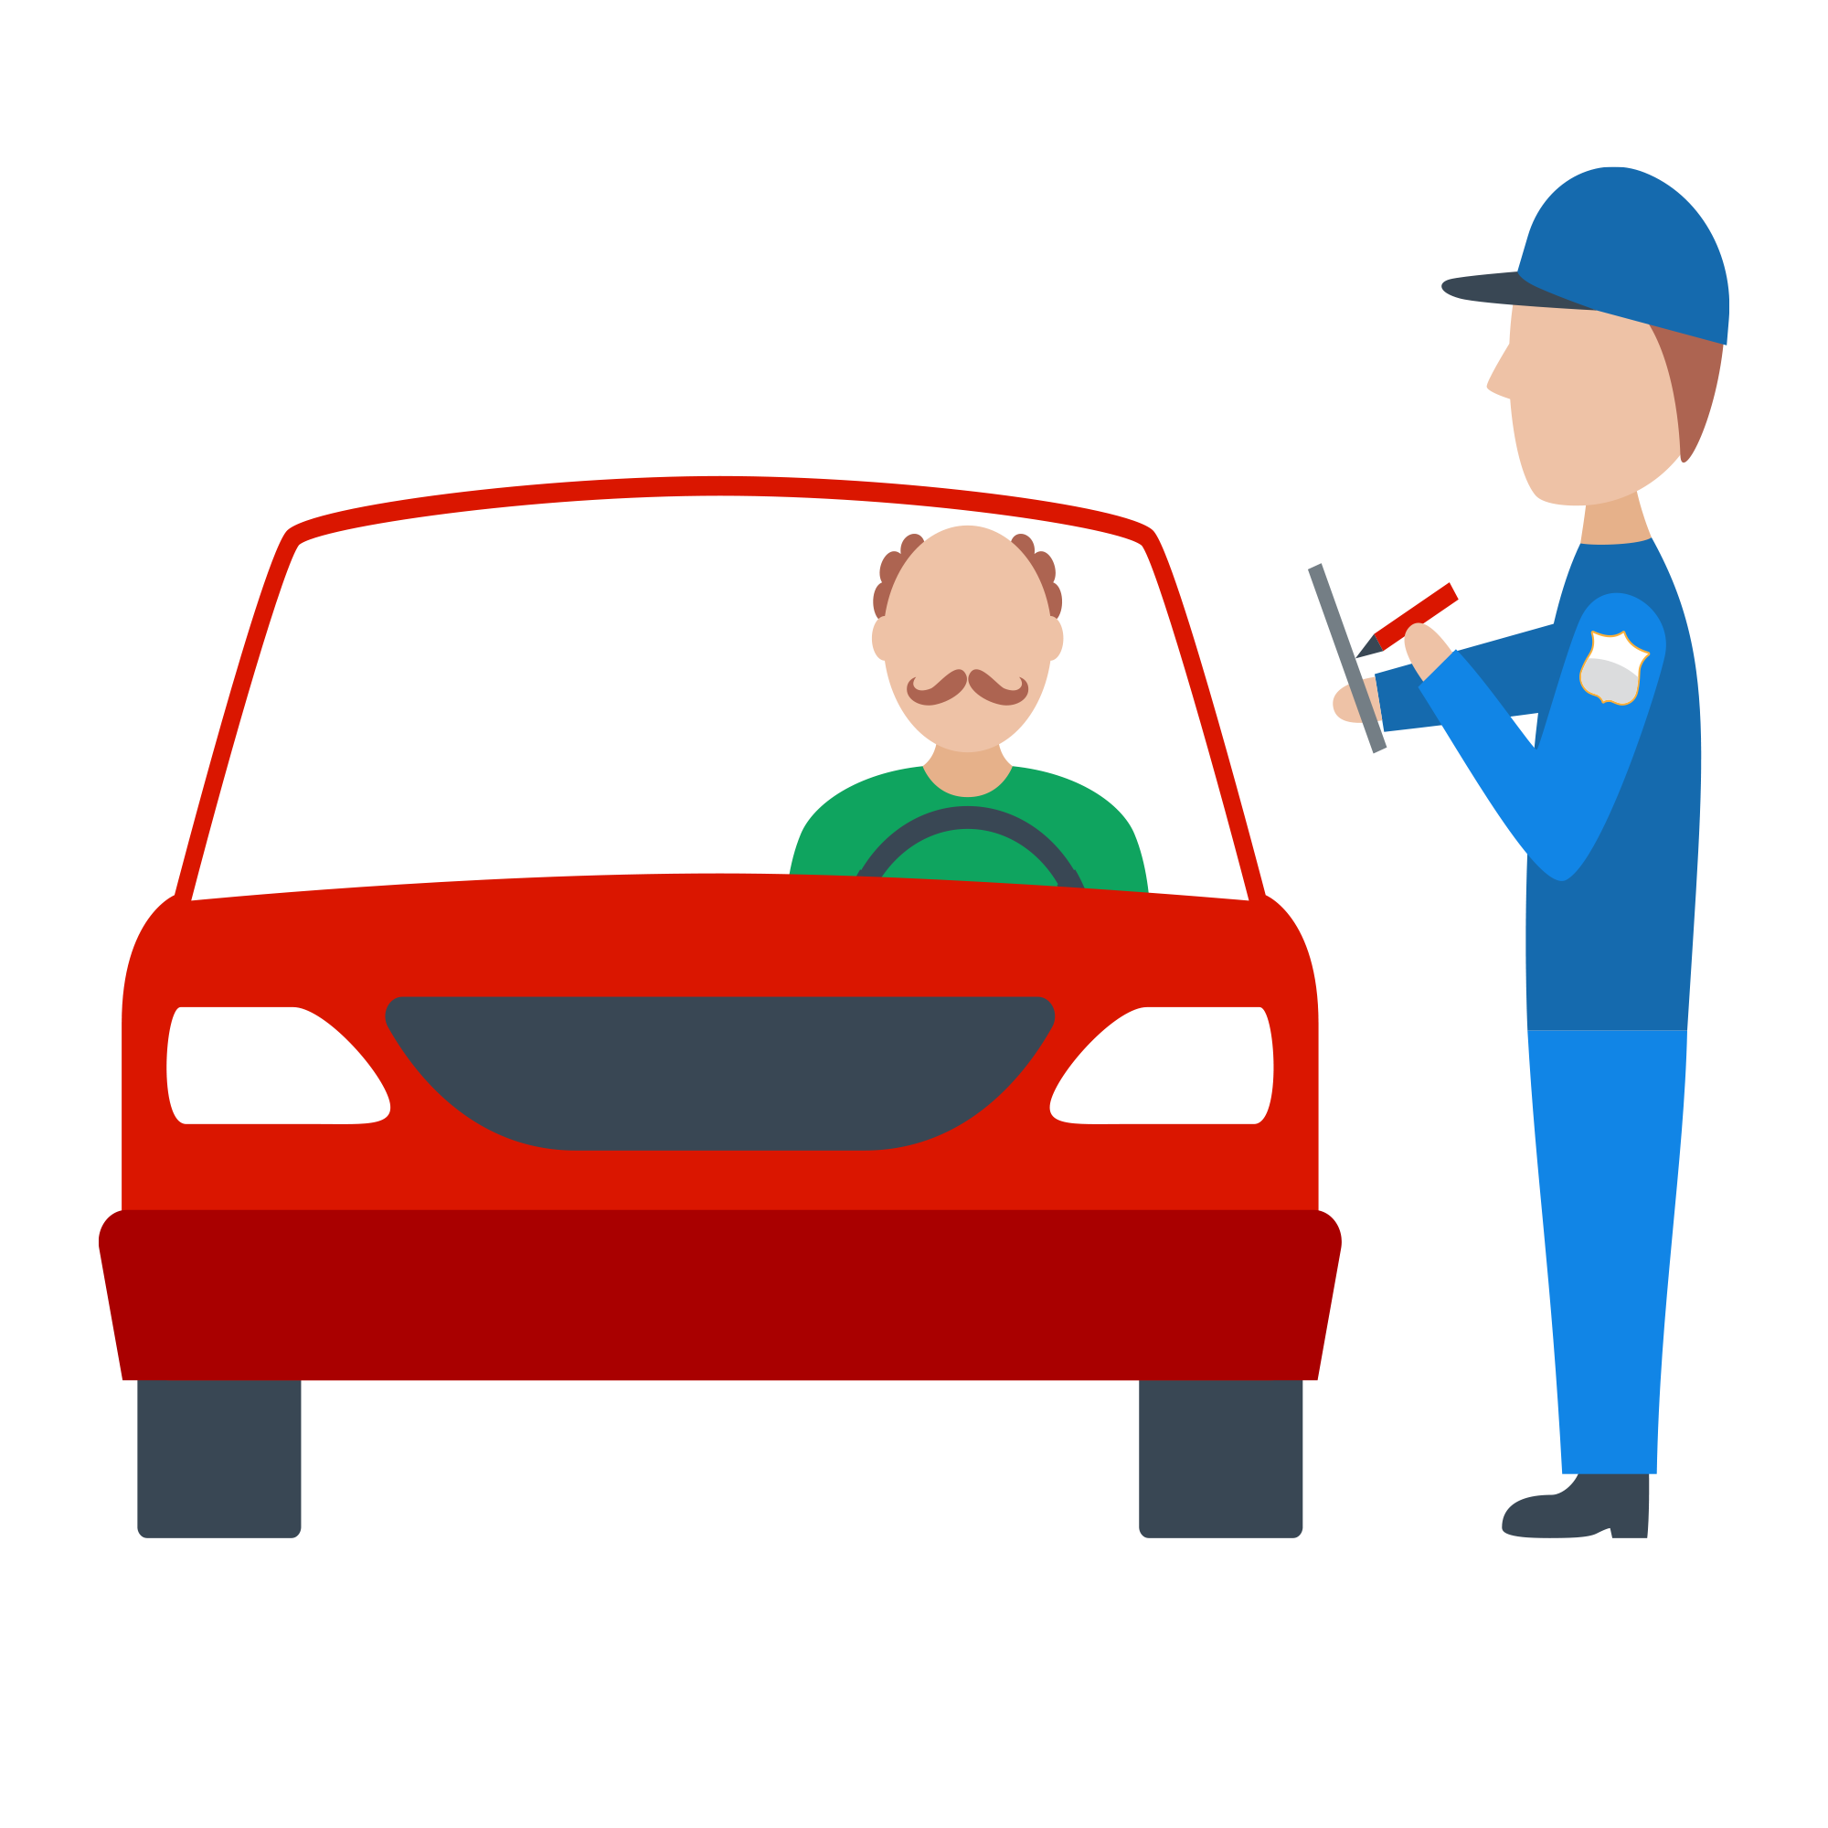
Introduction
Driver Behavior Based On Deep Learning

Slide 9
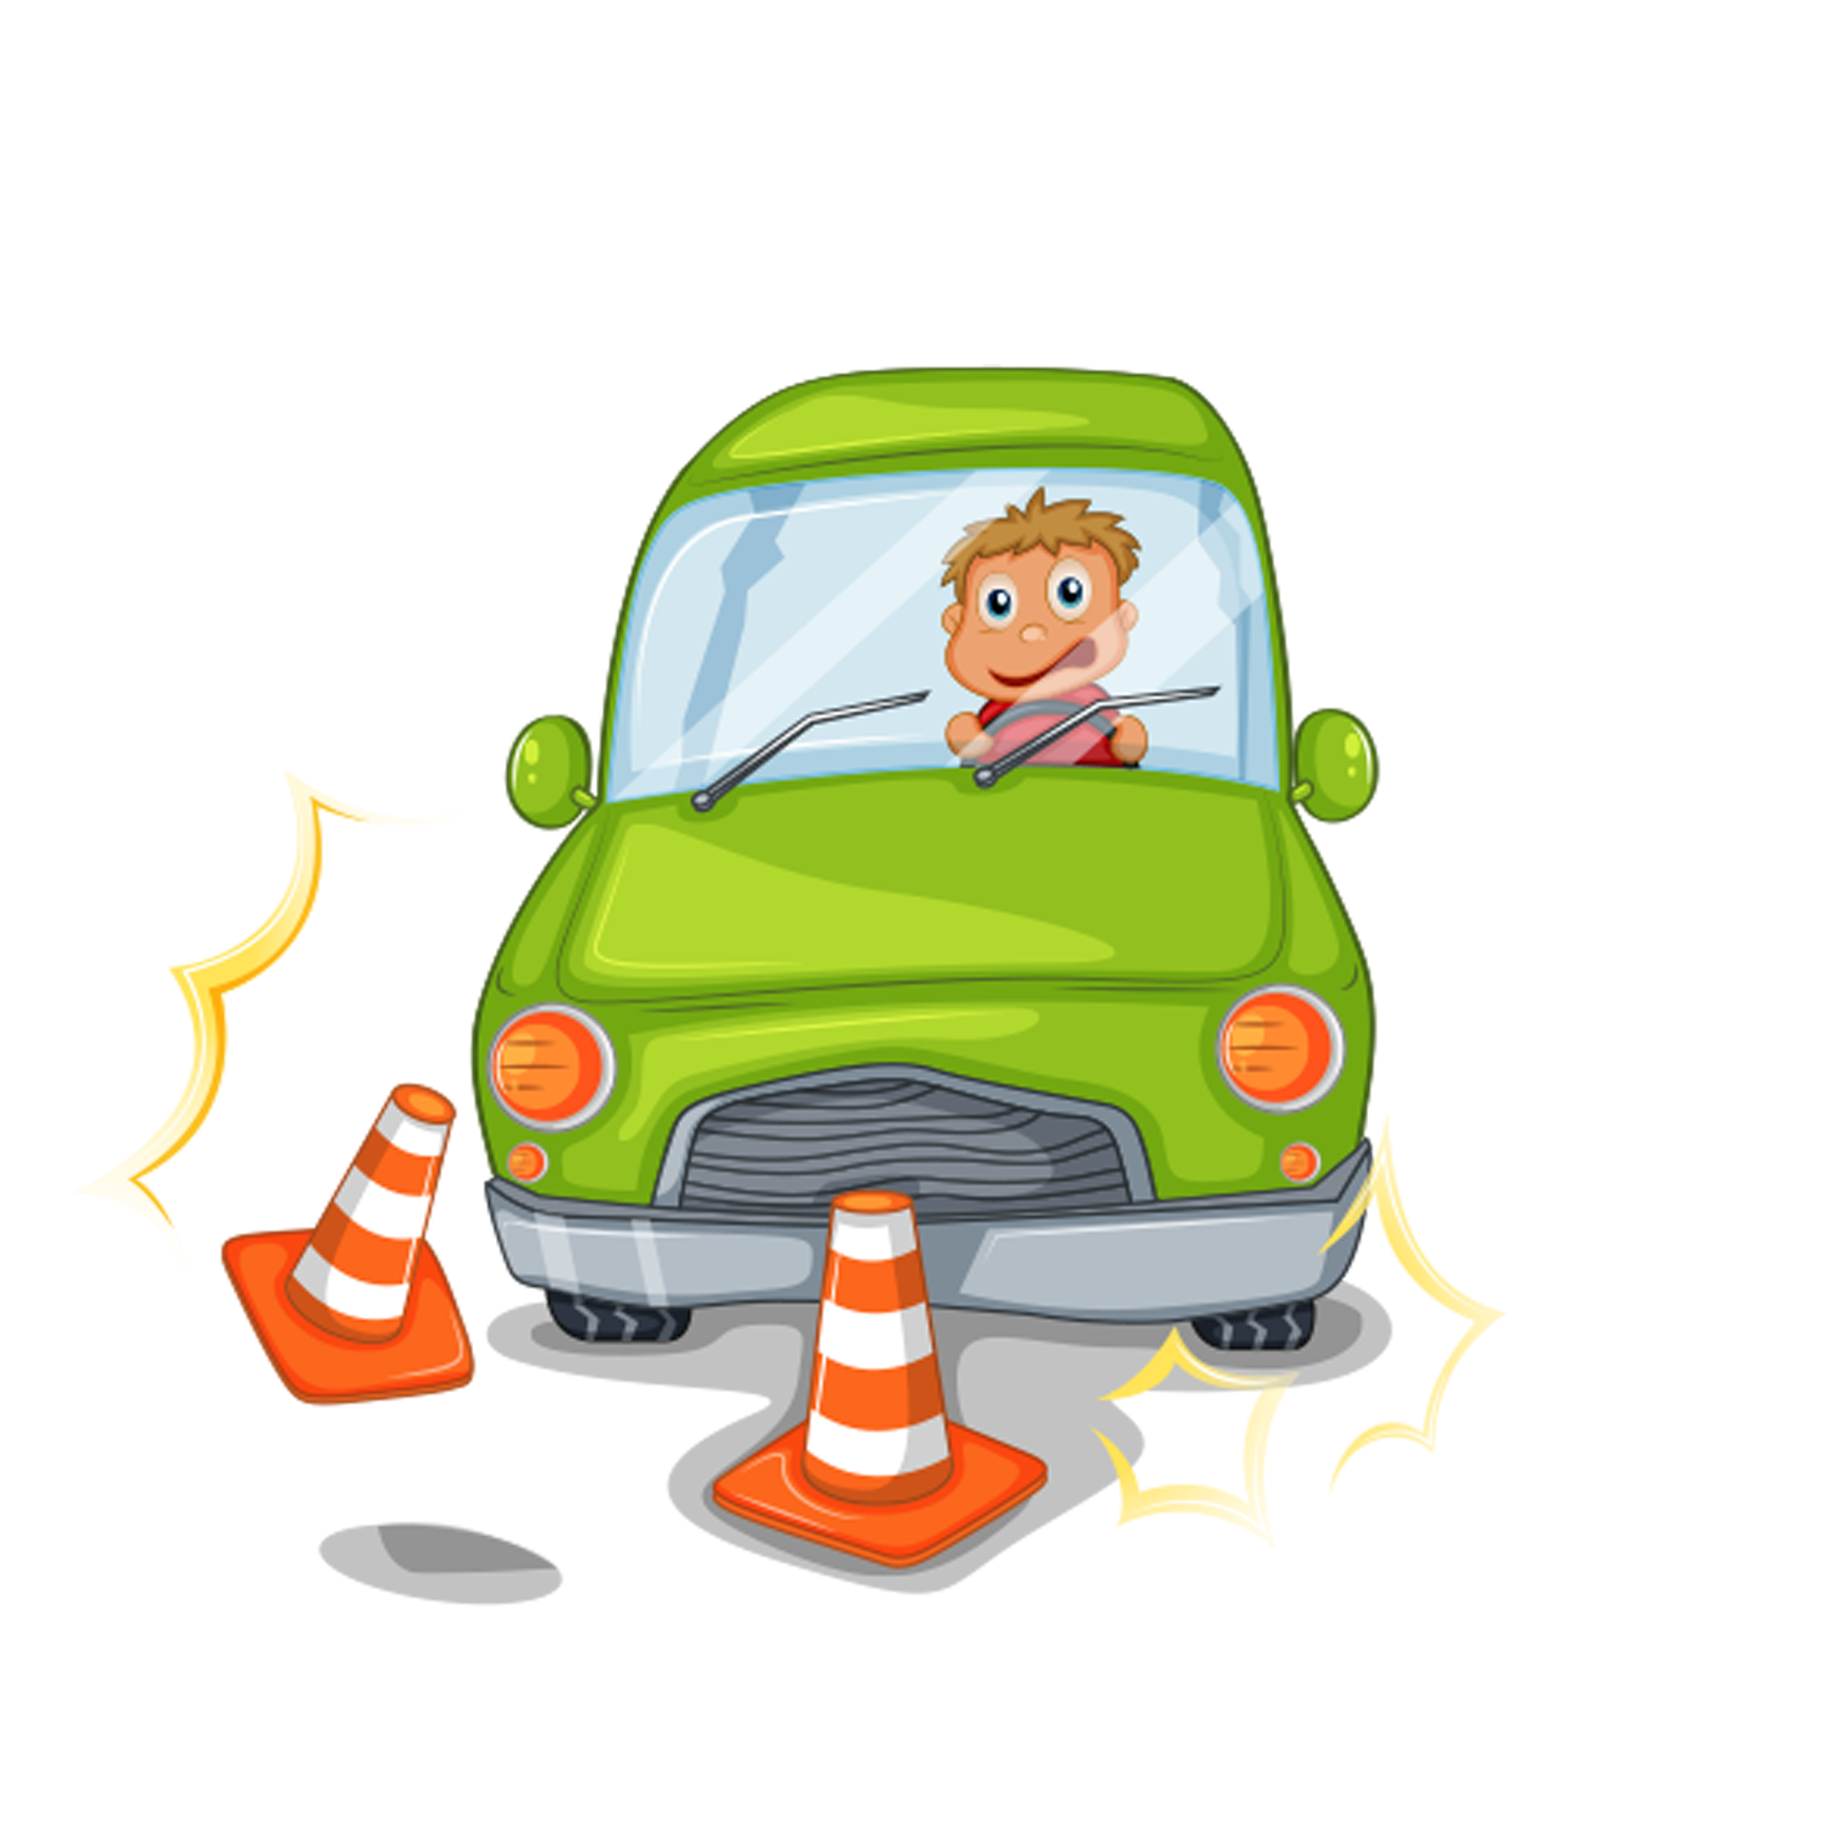
Introduction
?
What is our
Problem
The Bad Driver

Slide 10
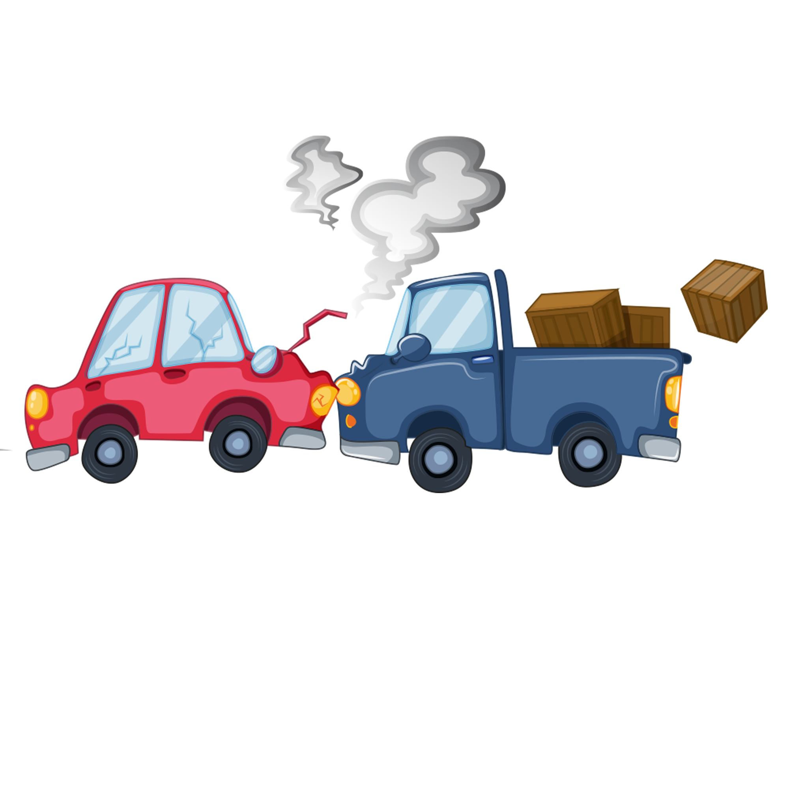
Problems
Human safety
Company outlay
Environment protection

Slide 11

?
What is our project
A device have the ability to collect enough data for car motion on the road by special sensors.
A Deep Learning Model to analysis data and classify the driver rate from the previous data and a GUI to show the result

Slide 12

How could our project solve the problem?
By driver behavior analysis

Slide 13

objectives
Providing a fair rate for driver behavior to help companies to choose the best driver for their services.
Providing a Full report to help the driver at the Development process by learning from his mistakes at The previous trip.

Slide 14


How did we build it?

Slide 15
The Device
Mission

Slide 16
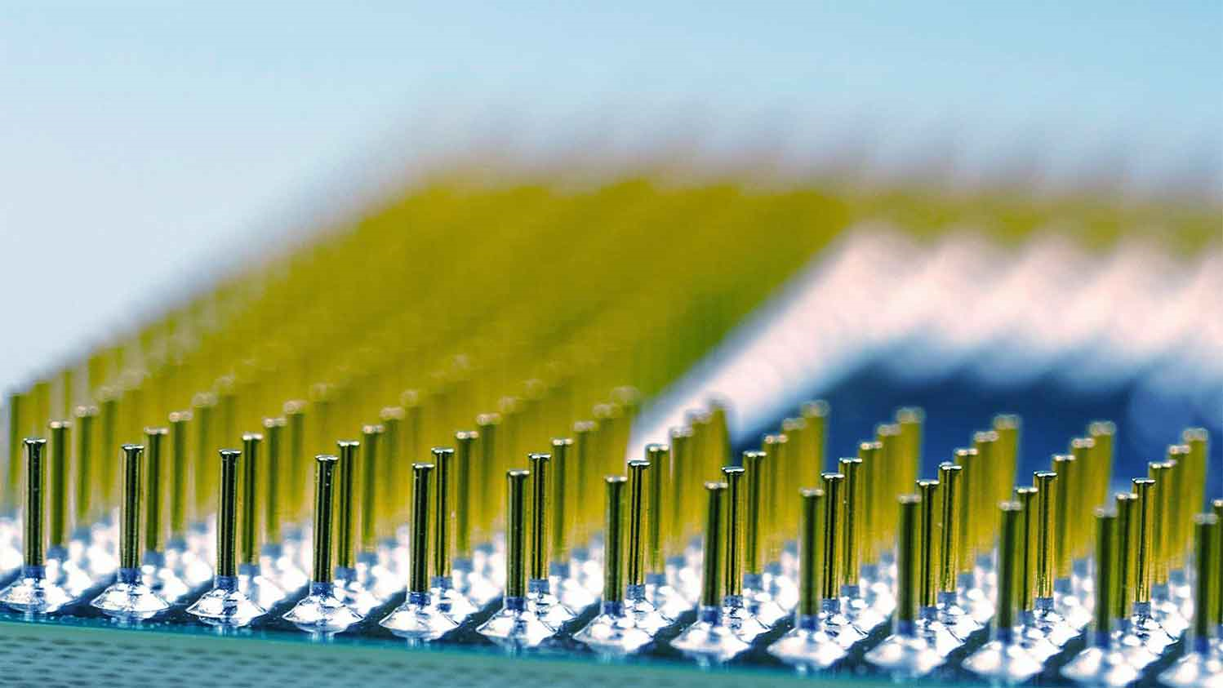
Why did we
Build
this device?
Data Collection
Data Uploading
Data Backup
Depending on some of the sensors with CPU we have the ability to read the changing at motion continually and with a lot of Readings we can say it we have Data.
To process Data by the AI Model we have a lot of ways. one of these, using the cloud services to pass data from our device to our processing zone. it's mean that one of the device tasks is data uploading to the cloud.
We know well how data is so important. but what if any problem happened for the online process. In fact, our device save a local file from data to prevent this problem or at least help to process it.

Slide 17
Components
Raspberry Pi
01
The Raspberry Pi is a type of single board computer (Credit card sized Computer).
Sensor (IMU)
02
Use the IMU sensor to track the motion of objects in the 3 coordinates (X Y Z)
with 9-axis.
Jumpers (wires)
03
used to connect devices
Power Bank
04
The Power Source for the device

Slide 18
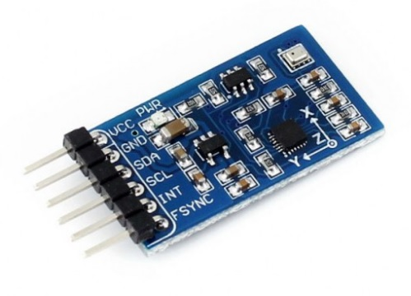
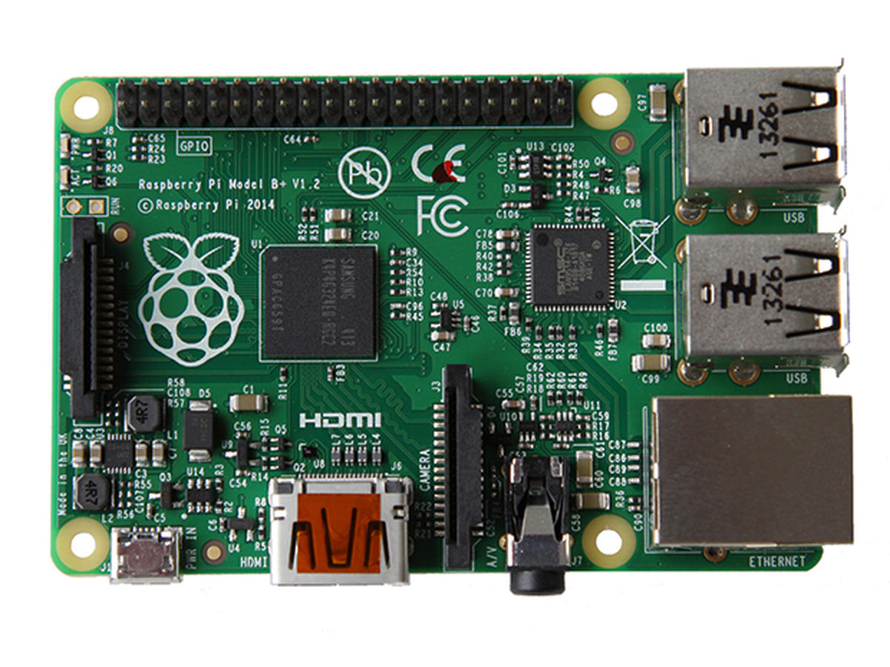
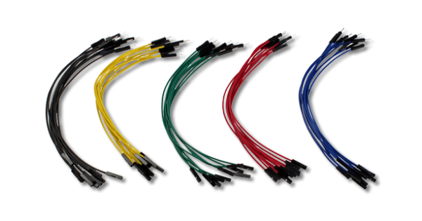
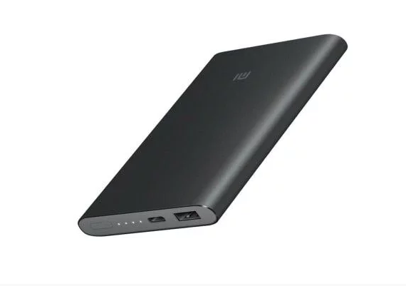
Components

Slide 19
Raspberry Pi → MPU-9250
Raspberry Pi
 | SDA
 | SCL
 | 3V
 | Gnd
MPU-9250
 | SDA
 | SCL
 | VCC
 | Gnd

Slide 20

Coding Time
Read& Write Data
Uploading Data
getting the sensor data and save it into variables, Saving the data in the excel sheet.
3
3
use JSON post Method to send data from the sensor to the firebase.
Create Excel File
Firebase Library
create it with the columns:-
Data, Time, UptimeNanos, 1X_Acelerometro, _1Y_Acelerometro, _1Z_Acelerometro,
2X_Giroscope,
_2Y_Giroscope,_2Z_Giroscope.
2
2
This library allows to send and get data from the firebase.
After that declare a variable to hold database URL.
Loading Library
START
Installing Firebase Package
1
1
In raspberry pi terminal use command Sudo to install it.
MPU Library
Datetime Library
Time Library
System Library
OS Library

Slide 21
AI

Slide 22





AI Model
Collect Data
Enhance Data
Build Models
Compare Models
Data need to enhance to make sure it’s clear to use
Generate AI Models to predict and to get result by training and testing
More than one model means You need to chose the best based on accurcy
Collect a data set that will be used to train and test model

Slide 23




Data Collection
We tried a lot to get a Data Set from Kaggle to Train and test model but, we couldn’t get it
We get a data set from GitHub
We sent a mail to connect with data collector to get a permission for using and editing Data Set and to get a lot of info.
*How does this look like ?
Data Set

Slide 24

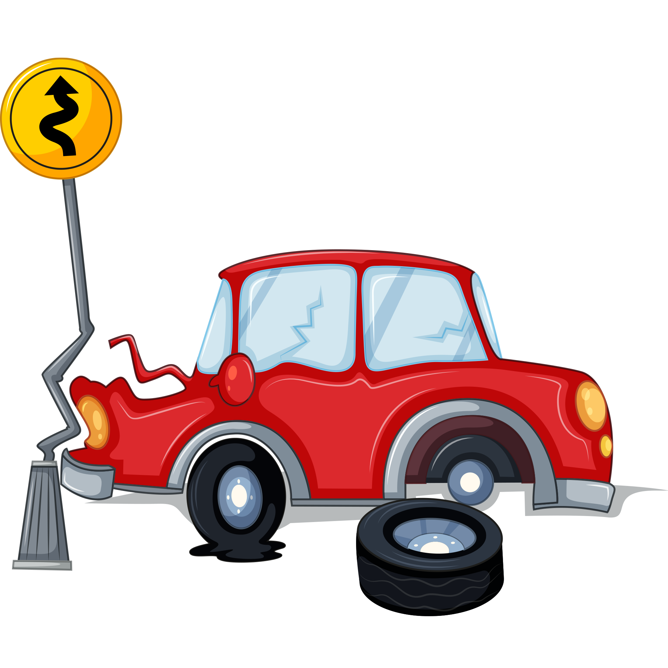
Data Set
While a driver executed particular driving events. An Android application is used to record smartphone sensor data.
like: -
Accelerometer
Linear Acceleration
Magnetometer
Gyroscope
The events: is our classes for action from driver during trip. We have 7 classes.
Aggressive Breaking
Aggressive Acceleration
Aggressive Left Turn
Aggressive Right Turn
Aggressive Lane Change
Non-Aggressive Event
Also, at the same time. A Camera record the trip to detect the events … Which events?!!
*So, Why did we need ?!
Data Enhancement

Slide 25


Data Enhancement
Data before Enhancement
Data After Enhancement
Separated
4 folders. folder per trip
Unlabeled
‘Groundtruth.csv’ file contains the camera report only.
‘Groundtruth.csv’ file has null value
Grouped
Labeled
Clear
*Now, we are ready to
Model Building
?

Slide 26

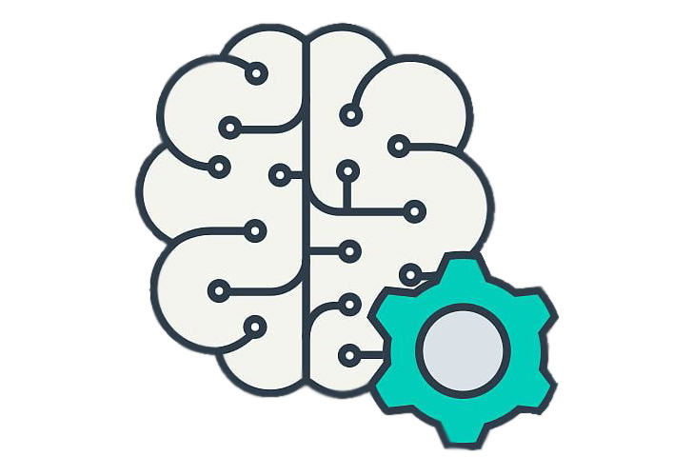
Model Building
We built several models to try to gain a lot of accuracies and choose the best model which is stable for problem-solving.
Machine Learning
Random Forest
Logistic Regression
Stochastic Gradient Descent
Support Vector Machine
Deep learning
Artificial Neural Network
Recurrent Neural Network

Slide 27

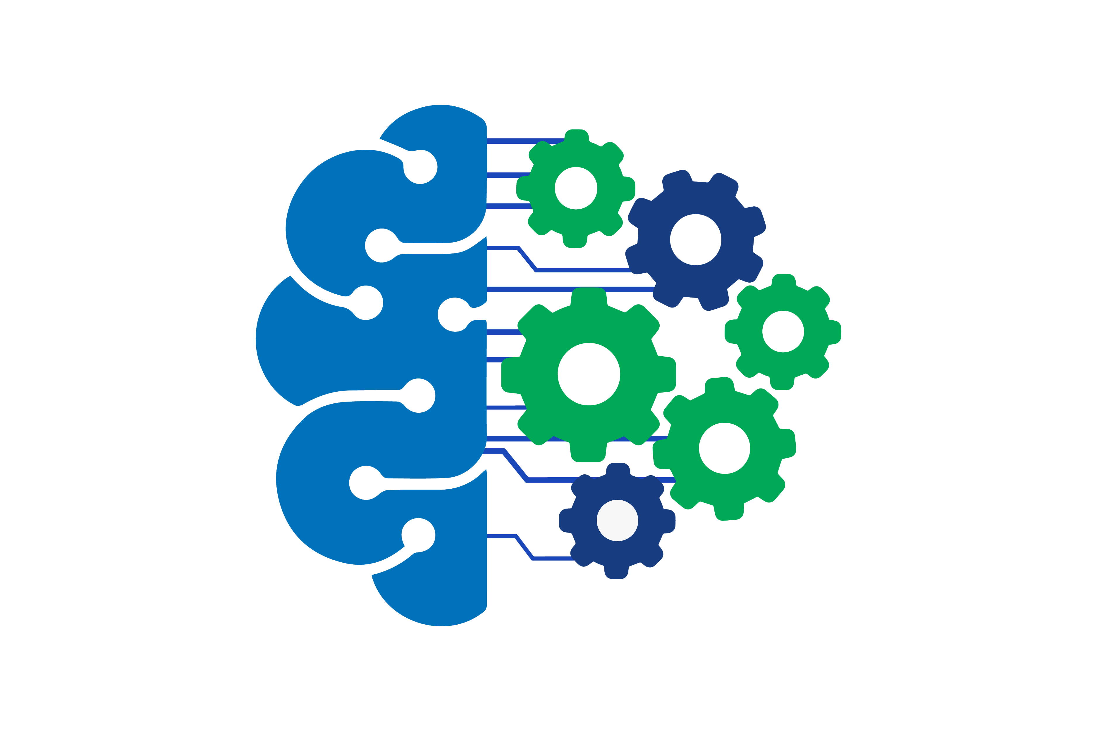
Models Comparison
Model | Degree | Accuracy | Test Ratio
Random Forest Classifier | 2 | 0.7736 | 0.25
Logistic Regression | 5 | 0.5661 | 0.25
Stochastic Gradient Descent | 2 | 0.4660 | 0.25
Support Vector Machine | 2 | 0.6379 | 0.25
Artificial Neural Network | 2 | 0.7662 | 0.20
Recurrent Neural Network | 2 | 0.9923 | 0.20

Slide 28


API
Create a local server
http://127.0.0.1:5000
Data Loading | Model Appling
-Make a connection with Firebase. -Load data from it | -Apply model for each record from data to get type of event (Class) -Make a ratio for every event during trip

Slide 29







Driver Rating
Class
Event | Result
Aggressive Right Curve | E1
Aggressive Left Curve | E2
Event No Aggressive | E3
Exchange Aggressive Lane | E4
Aggressive Breaking | E5
Aggressive Acceleration | E6
Rate | Y
Evaluation | Class
Dangerous
Less than 35%
Bad
35 : 50%
Not Bad
50: 65%
Good
65: 85%
Perfect
Greater than 85%
Rating Equation
Y = (-(E1+E2+E4+E5+E6)+4*E3+100)/500)

Slide 30


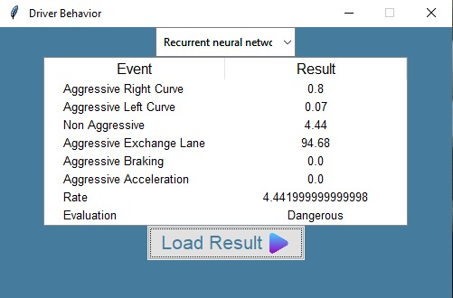

GUI
Python with Tkinter library was a good partner to build an interface provide to the user
Select the model
Load report (result)
Model applaing

Slide 31

Project Demo
Load from Sensor
Save at Sheet
Upload To firebase
Run API Server
Run GUI
Test Models

Slide 32

Thank You

